Slide 1
Senior Project Presentation 1
Sean Waksmundski, Alex Powers, Shane Perez

Slide 2
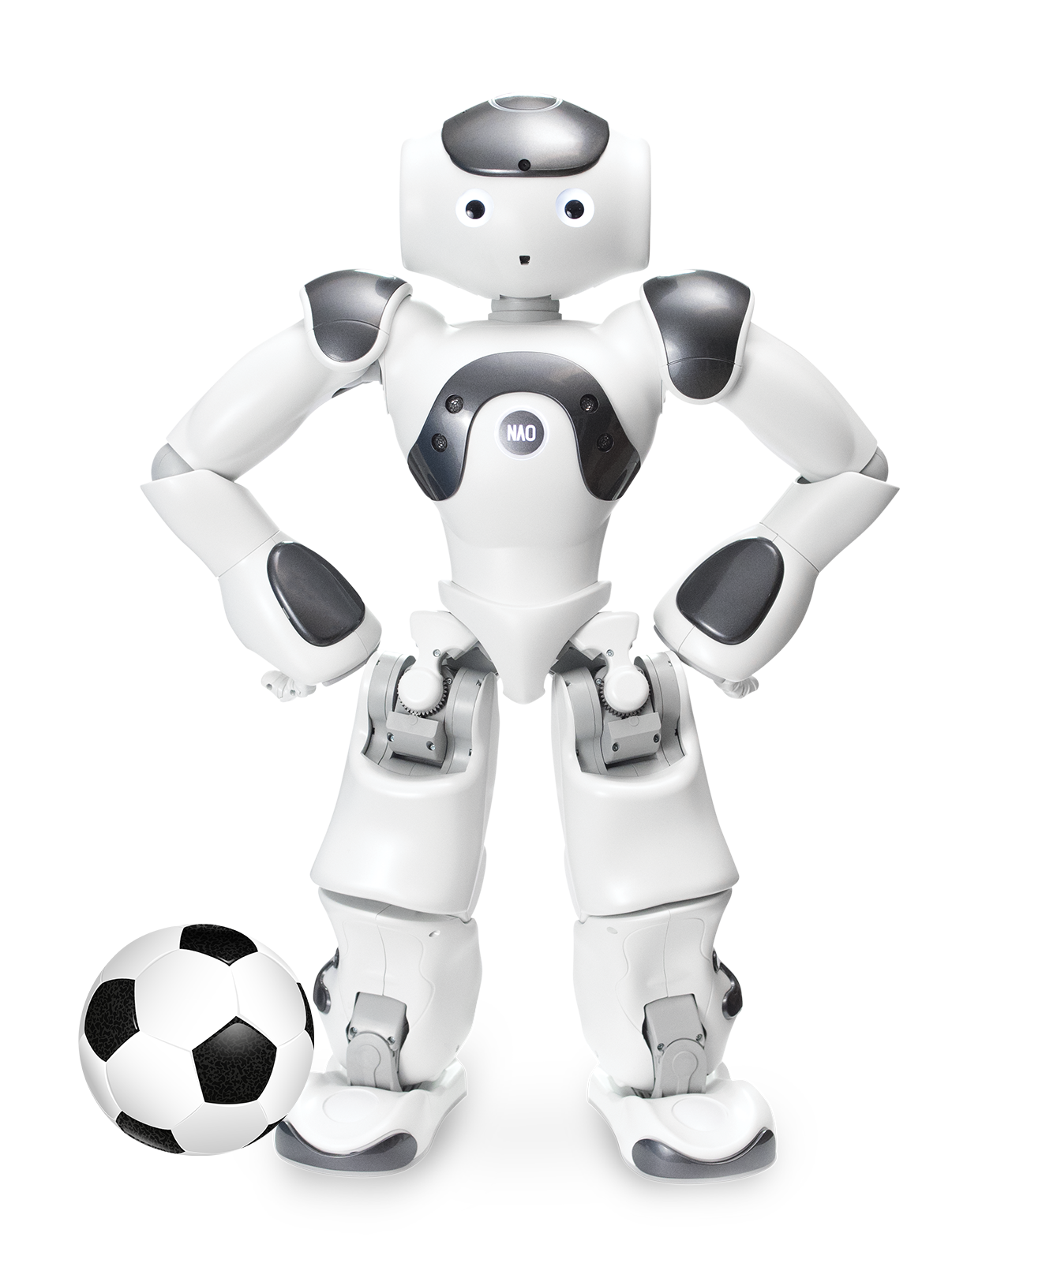
NAO AI Robot Programmable
Our project is programming a NAO AI Robot that operates and drives an autonomous vehicle following standard common traffic regulations.
Delegated Roles for each Team Member
Alex - Upgrade sensory system to recognizing traffic lights, lanes, and other obstacles.
Sean - Programming NAO using the Choregraphe language, microcontroller connections
Shane - Responsible for designing elements for the rules of the road, such as using CAD to design and make obstacles such as a stop sign or 3 color traffic light. As well as seeing how the buttons work by turning right or left with pressing them.

Slide 3
What we have accomplished
Here is what we have done so far in Systems Engineering and this class.
Made a House of Quality to quantify different characteristics of the project
Developed specifications for the system components
Packaged the system into major elements based on the components’ functions
Obtained information from the previous team on the status of the system and issues that need to be addressed
Created a website to host documentation for the project
Researched different components to find the best option for function and value

Slide 4
What we plan to do
Expand on our Systems Engineering work by . . .
Remaining organized and well-documented
Continuing to run necessary tests and analysis methods to keep our project up to optimal standards
Maintaining a clear vision for our project and how it will address the problem statement
Improve functionality of the existing Nao Robot vehicle system by . . .
Adding extra layers of awareness to our system including lane, stoplight, and destination detection
Implementing new functions for our system that will upgrade the versatility of our system

Slide 5
Highlighting and Addressing Problems
Here are the immediate problems from the current design that we plan to address . . .
Relatively low utilization of the Nao Robots potential while relying too much on the vehicle itself
System is missing some necessary functionality such as turning left
Limited range and versatility of the sensors
System is not fully autonomous yet and cannot be remote controlled

Slide 6
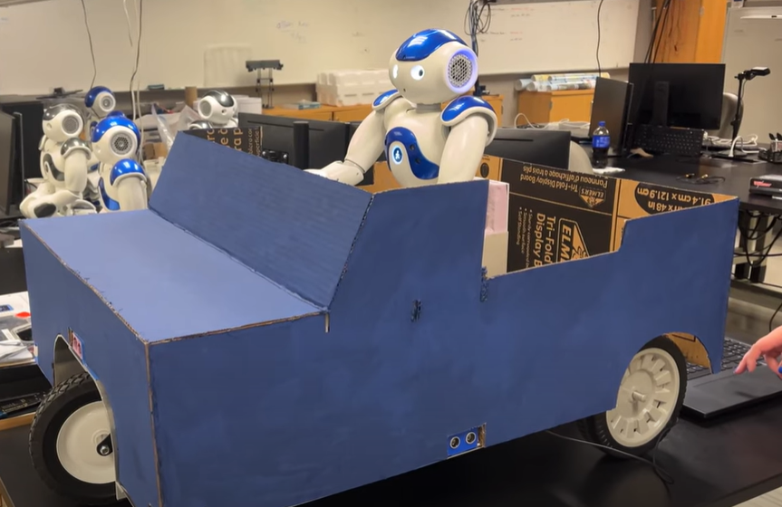
Conclusion
We have a good foundation for the NAO based on the previous group. We plan on meeting as a group twice a week on Mondays and Fridays, as well as working in the Crois Lab when we have free time. Also, we have scheduled weekly meetings with our technical advisor, Dr. Kim.
In the coming weeks, we look forward to improving the design of the chassis and acquiring the sensors needed to have the system move autonomously.

